Slide 1



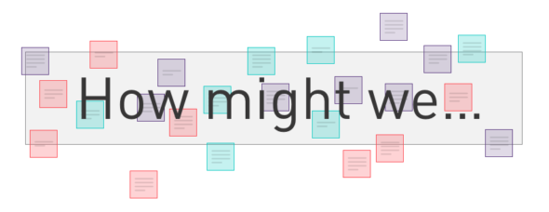
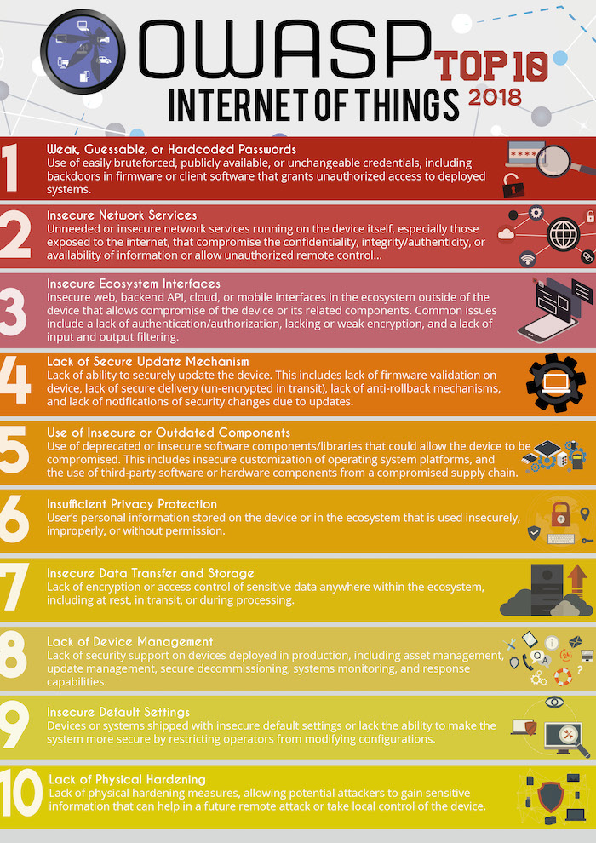
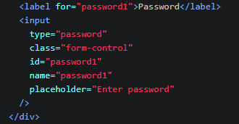
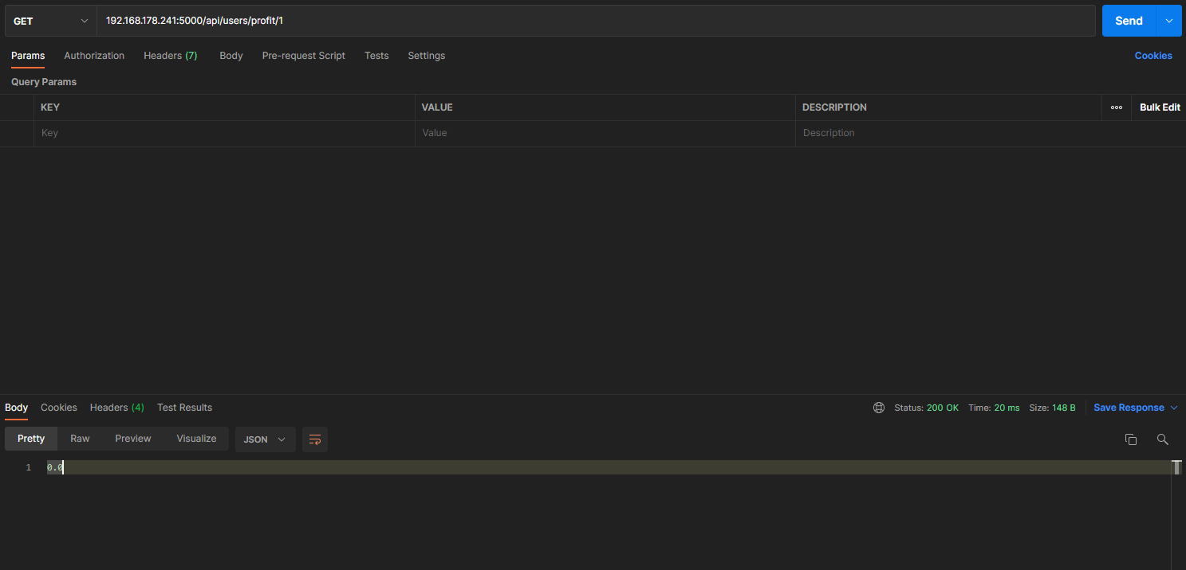
IoT Profile poster (To the moon)
Ferran Tombal
500799894
Research question
Research (TMC cycle)
Critical analysis
Chosen profile: Infrastructure and security
How might we research and improve the security and infrastructure of the product so that it meets, for example, the OWASP top 10 analysis requirements.
Link to the OWASP top 10 for IoT devices:
https://www.venafi.com/blog/top-10-vulnerabilities-make-iot-devices-insecure
Library (Think):
The chosen library method is literature study.
I will go through each the 10 OWASP IoT vulnerabilities and I’m going to check if the Crypto alert application has any of these vulnerabilities.
Since I’m using the Flask framework for the web application, I’m going to research the specific Flask vulnerabilities, I will do this by searching on the internet and reading the Flask documentation.
Field:
I’ve chosen to do the problem analysis as the Field method. Before solving a problem, it is important to understand it. Moreover, problem analysis ensures that you are not solving the wrong problem.
Problem analysis:
Why is this a problem:
Good security is essential to protect a product from hackers and other malicious users. The OWASP Top Ten is an expert consensus of the most critical risks facing web applications and the teams who are developing them
What happens if it wouldn’t’ be solved:
Web security is important to keeping hackers and cyber-thieves from accessing sensitive information. Without a proactive security strategy, This product risks the spread and escalation of malware, attacks on other websites, networks, and other IT infrastructures.
To whom is it a problem:
To users using the product or other networks that are connected to the product (Web application or embedded device) in some way.
Workshop:
https://ictresearchmethods.nl/Root_cause_analysis
Make:
After researching the specific vulnerabilities of the Crypto alert application. I’m going to improve the security of the application.
Lab (Check):
Since my research question is about how to improve the security of the Crypto alert application, I’m going to do some penetration testing to test whether my interventions have worked after making the application more secure.
https://ictresearchmethods.nl/Security_test
Also, before I have improved the security of my application. I will do penetration test to test the security beforehand.
Chosen research strategies:
Action oriented research
Some penetration testing (A penetration test is a simulated cyber attack against a computer system) will be done to test the security of the application to find any exploitable vulnerabilities. Penetration testing will also be done after fixing the vulnerabilities to test the results.
Tools used to do penetration testing:
- Burp Suite (To simulate brute force attacks)
- Postman (To find API vulnerabilities by simulating HTTP requests)
Secondary research (Desk research)
The OWASP top 10 analysis will be compared the Crypto alert application and if those requirements relate to the application they’ll have to be fixed.
Finally, since the web application of the Crypto alert product makes use of the “Flask” framework. some research will be done on the Flask specific security considerations:
https://flask.palletsprojects.com/en/2.0.x/security/
Some of those considerations will also be implemented in the application.
Data and findings
- Broken authentication
As you can see in the picture above, the application had broken authentication since it didn’t have enforce strong user passwords, therefore user passwords could easily be brute forced.
Unauthenticated API
The API didn’t make use of any authentication, therefore anyone could get the profit of any other user if they found out the API endpoint.
No usage of security headers
The Flask-Talisman module was used for an extra security measure that manages the security headers.
Conclusion
This research sought to answer the question:
“How might we research and improve the security and infrastructure of the product so that it meets, for example, the OWASP top 10 analysis requirements.”
Qualitative research has been carried out into various sources like the OWASP top 10 for IoT devices and Flask security considerations to find possible vulnerabilities of the Crypto Alert application. Also some practical research (Penetration testing) before and after improving the application was done to find vulnerabilities and validate the results.
Looking at the results, the application had some security vulnerabilities. One of them was “Broken authentication”. Users were able to create weak passwords without using any capital letters, numbers or special characters. Therefore the authentication was “broken” and user passwords could be brute forced more easily. Broken authentication has been improved by enforcing strong user password checks in the front and backend.
Furthermore, the “Get user profit” API endpoint didn’t make use of any authentication, therefore anyone could get the profit of any other user if they found out the API endpoint. This vulnerability has been fixed by using Basic Authentication of flask-HTTPAuth library to protect the API endpoint.
Finally, the Flask-Talisman module was used to force all connects to HTTPS instead of HTTP and to manage the security headers.
A
B

